Slide 1
State of the Pandemic
Dr. Walensky

Slide 2
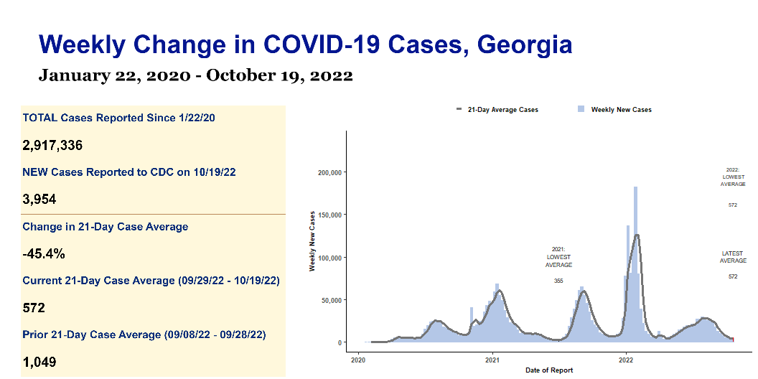

Slide 3
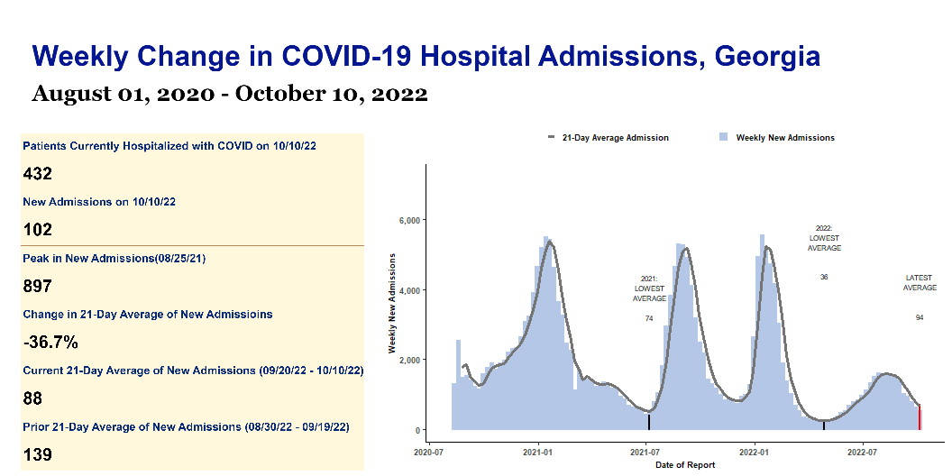

Slide 4
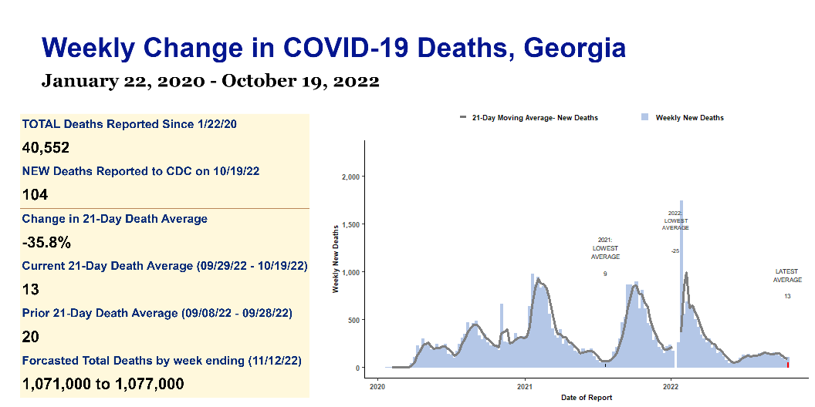

Slide 5
Georgia Weekly COVID Report | Georgia Weekly COVID Report | Georgia Weekly COVID Report | Georgia Weekly COVID Report | Georgia Weekly COVID Report
s | s | s | s | s
Key Metrics | Key Metrics | Key Metrics | Key Metrics | Key Metrics
indicator | Total to date | Most recent week | Daily average | Period-on-period change
Cases | 2,917,336 | 3,954 | 572 | -45.4%
Hospital Admissions | 213,841 | 581 | 83 | 2.5%
Deaths | 40,552 | 104 | 13 | -35.8%
Test Positivity | 12.5% | N/A | 5.9% | -6.9%

